Slide 1

BCT 207
System Analysis & Design

Slide 2
Recommended Books
Obeng, A. Y. & Opoku, S. K. (2023). Fundamentals of Current and Emerging Trends in Systems Development. 1st Edition. White Falcon Publishing.
Valacich, J. S. & George, J. F. (2021). Modern Systems Analysis and Design, 9th Edition. Pearson Education Limited.
Tilley, S. (2020). Systems Analysis and Design, 12th Edition. Course Technology, Cengage Learning

Slide 3
PART 1 ■ Introduction to System Development
Chapter ONE
An Overview of Systems Analysis and Design

Slide 4
Chapter One Outline
Software Development and Systems Analysis and Design
The Analyst as a business problem solver
Tasks performed by Systems Analyst
Required skills of the Systems Analyst
What is a system?

Slide 5
The task at hand is to create and submit a game.
Do you have any concern?
Who will use the game/system?
What will the game/system do?
Where will the game/system be used?
When will the game/system be used?

Slide 6
Group students for the following exercise
Student admission system – GROUP 1
Automated Teller Machine (ATM) – GROUP 2
Virtual class – GROUP 3
Library management system – GROUP 4
Who will use the system?
What will the system do?

Slide 7
1.1 Software Development and Systems Analysis and Design
The primary goal of systems analysis and design is designing computerized information systems to solve a problem within organizations.

Slide 8
Almost all organizations have information systems, and use them for operational, tactical, and strategic advantage.
The modern information systems service emphasis changes from being merely an enabler of services to also being a driver of change.
Information systems have become a necessary component in any organisation with increasing strategic significance.
Business continuity is a key aspect as 99.5% of system availability is no longer acceptable with increased reliance on information systems.

Slide 9
The information systems discipline is dynamic and always changing.
More complex system requirements have necessitated a whole new set of tools.
System, product, or service should be delivered without latent defects, on schedule, and within budget.
These information systems should be developed.
The key to successful system development is thorough systems analysis and design.
Systems analysts and designers perform information systems analysis and design.

Slide 10
Successful system development is based on:
understanding an organization’s objectives, structure, and processes
the analyst’s knowledge of how to exploit information technology

Slide 11
What is Analysis?
The Oxford Dictionary defines analysis as follows: separation of a substance into parts for study and interpretation; detailed examination.
In the case of systems analysis:
the substance is the business system (e.g. student examination system) under investigation
the parts are the various subsystems (e.g. programme, course) that work together to support the business.

Slide 12
It is important that the nature of the business and the way it currently operates are clearly understood.
Detailed examinations provide the design team with the specific data they require in order to ensure that all the client’s requirements are fully met.
The investigation or study conducted during the analysis phase results in the production of a document called requirements specification or functional specification.

Slide 13
Systems analysis is the process of understanding and specifying in detail what the information system should accomplish.
The analysis phase answers the questions of who will use the system, what the system will do, and where and when it will be used.

Slide 14
Systems design is the process of specifying in detail how the many components of the information system should be physically implemented.
This is concerned with:
the hardware, software, and network infrastructure;
the user interface, forms, and reports that will be used;
the specific programs, databases, and files that will be needed

Slide 15
Systems analysis and design is a systematic approach to identify problems, opportunities, and objectives, analyse the information flows in organizations, and design computerized information systems to solve a problem within organizations.

Slide 16
Why is systems analysis and design important?
Success of information systems depends on good SAD
It is proven techniques and widely used in computing industry
It is part of career growth in IT - lots of interesting and well-paying jobs.
Because of the increasing demand for systems analysis skills

Slide 17
1.2 The Analyst as a Business Problem Solver
Systems analyst is a business professional who uses analysis and design techniques to solve business problems using information technology
A systems analyst is someone who solves business problems using information technology
Problem solving means looking into the problem in detail, understanding everything about the problem, generating several alternatives for solving the problem, and then picking the best solution
Systems analyst must bring to the job a fundamental curiosity to explore how things are done and the determination to make them work better
The analyst must first understand the problem and learn everything possible about it— who is involved, what business processes come into play, and what other systems would be affected by solving the problem
Building a system based on incomplete or misunderstood requirements ensures that the project will be over budget, late, and will deliver a system that does not fully solve the problems it was intended to address.

Slide 18
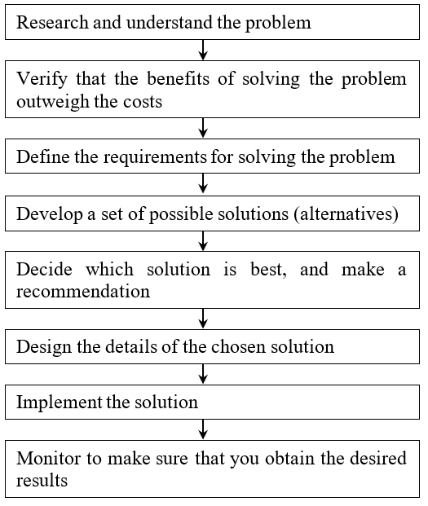
Figure 1: The Analysts’ Approach to Problem Solving

Slide 19
1.3 Tasks Performed by Systems Analyst
Investigation: This group of tasks consists of all the fact-finding activities that an analyst may have to undertake
Communication with customers: Many analysts regard this as the single most important factor in ensuring a successful outcome to the analysis and producing an accurate specification of the client’s requirements
Documentation: The production of documentation, like communicating with the customer, is a broad heading that encompasses many tasks
Understanding: This is a heading that really includes all the others, because at the heart of the analyst’s job is the desire to understand the information collected, so that they can pass on this understanding to others on the project
Planning: This group of tasks will include the planning of analysis activities, estimating how long these activities will take, and scheduling them to fit in with the project plan

Slide 20
1.4 Required Skills of the Systems Analyst
Systems analysts need a wide variety of specific skills
First, they need to be able to understand how to build information systems, which requires quite a bit of technical knowledge
Understand that people are the source of information about requirements, the labour that builds systems, and the ultimate users of the information system

Slide 21
Technical Knowledge and Skills
Computers and how they work
File, database, and storage hardware and software
Input and output hardware and software
Computer networks and protocols
Programming languages, operating systems, and utilities
Communication and collaboration technology such as digital telephones, videoconferencing, and Web-based document management systems

Slide 22
Technical Knowledge and Skills
Software packages such as Intuit QuickBooks, Microsoft Access, and Adobe Dreamweaver that can be used to implement small systems or develop subsystems
Integrated development environments such as Oracle JDeveloper and Microsoft Visual Studio that support program development, database design, software testing, and system deployment
Computer-aided visual modelling tools, such as Visible Analyst that help analysts create, store, modify, and manage system specifications and sometimes generate programs, databases, Web-based interfaces, and other software components
Automated testing tools, configuration management tools, software library management tools, documentation support tools, project management tools, and so on

Slide 23
Business Knowledge and Skills
What business functions do organizations perform?
How are organizations structured?
How are organizations managed?
What type of work goes on in organizations ?

Slide 24
Business Knowledge and Skills
What the organization specifically does
What makes it successful
What its strategies and plans are
What its traditions and values are

Slide 25
People Knowledge and Skills
Interpersonal skills are the analyst’s most important skills because analysts rely on others including managers, users, programmers, technical specialists, customers, and vendors to take a system from initial idea to final implementation
The analyst is a translator for all project participants, translating business objectives into functional requirements, user needs into system specifications, and technical jargon and details into terms that nontechnical personnel can easily understand
Analyst must develop rapport with users who may be resistant to change, negotiate with management for resources such as budget, time, and personnel, and manage development personnel with many different skills, capabilities, and attitudes

Slide 26
Communication Skills
A systems analyst needs strong oral and written communication skills, and the ability to interact with people at all levels, from operational staff to senior executives
Analysts often coordinate Information Technology project teams, where they use communication skills to guide and motivate team members

Slide 27
Analytical skills
Problem solving skills
System thinking
Ability to see organizations and information systems as systems

Slide 28
1.5 What is a System?
A system is composed of regularly interacting or interrelating groups of activities to achieve a specific goal.
System theory is the interdisciplinary study of systems in general, with the goal of explaining principles that can be applied to all types of systems at all levels in all fields of research
Systems theory views the world as a complex system of interconnected parts

Slide 29
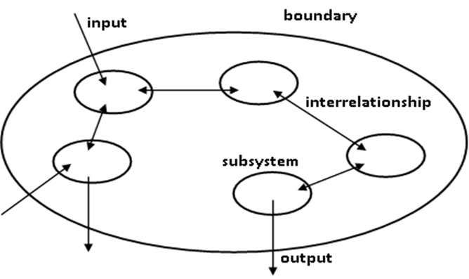
Figure 1-3: General illustration of a system

Slide 30
The main principles of system theory
Systems theory focuses on the system's structure instead of on the system's function
Systems theory theories explicitly state that changing one of the subsystems could have an impact on the total system
Systems theory classifies systems into hierarchies
Systems theory can be helpful in analysing business processes and finding inefficiencies
a collection of interrelated components that function together to achieve some outcome
a piece of software that operates to manage a related collection of tasks
a design for an organization that perceives sets of processes as a related collection of tasks; or
a bounded transformation process; collection of processes that transforms inputs into outputs

Slide 31
Common characteristics most systems share
Systems have structure which is defined by parts and their composition
Systems have behaviour which involves inputs, processing, and outputs of information
Systems have interconnectivity where the various parts of a system have functional as well as structural relationships between each other
Systems have by themselves functions or groups of functions
Each element influences the functioning of the entire system
Each element is affected by at least one other element in the system

Slide 32
1.6 Information Systems
An information system is a collection of interrelated components that collects, processes, stores, analyses, and disseminates information for a specific purpose
It has been said that the purpose of information systems is to get the right information to the right people, at the right time, in the right amount, and in the right format
For this reason, the term "information system" is typically used synonymously with "computer-based information system." The basic components of computer-based information systems are hardware, software, network, database, procedures, and people

Slide 33
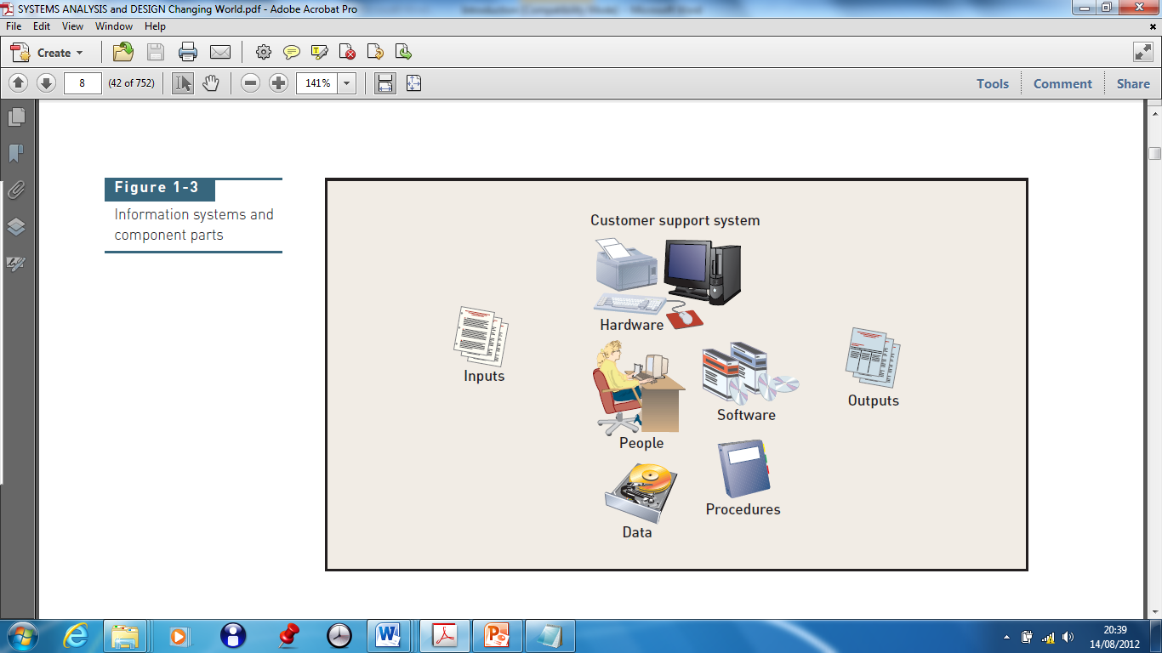
Information systems and component parts

Slide 34
Brief Description of Information System Components
Hardware consists of everything in the physical layer of the information system
Software refers to the programs that control the hardware and produce the desired information or results
Database: A database is a collection of related files, tables, relations, and so on, that stores data and the associations among them
Network: A network is a collection of computers and devices connected via communications devices and transmission media that permits resource sharing
People who have an interest in an information system are called stakeholders
Procedures are the instructions for combining other components to process data and generate the desired output

Slide 35
Types of Information Systems
Customer relationship management system is a system that supports marketing, sales, and service operations involving direct and indirect customer interaction
Supply chain management system is a system that seamlessly integrates product development, product acquisition, manufacturing, and inventory management
Accounting and financial management system is a system that records accounting information needed to produce financial statements and other reports used by investors and creditors
Human resource management system is a system that supports employee-related tasks such as payroll, benefits, hiring, and training
Manufacturing management system is a system that controls internal production processes that turn raw materials into finished goods

Slide 36
Types of Information Systems
Knowledge management system is a system that supports the storage of and access to documents from all parts of the organization
Collaboration support system is a system that enables geographically distributed personnel to collaborate on projects and tasks
Business intelligence system is a system that supports strategic planning and executive decision making

Slide 37
1.7 Main Reasons for Starting Information Systems Projects
The starting point for most projects is called a system request, which is a formal way of asking for IT support.
A systems request proposes:
enhancements for an existing system
correction of problems
replacing an older system
developing an entirely new information system

Slide 38
1.7 Main Reasons for Starting Information Systems Projects cont…
Improved Service – Systems requests are often aimed at improving service to customers or users within the company
Support for New Products and Services – New products and services often require new types or levels of IT support
Better Performance – The current system might not meet performance requirements
More Information – An existing system might produce information that is insufficient, incomplete, or unable to support the company’s changing information needs
Stronger Controls – A system is required for effective controls to ensure that data is secure and accurate
Reduced Cost – The current system could be expensive to operate or maintain because of technical problems, design weaknesses, or the changing demands of the business
Conform to a Directive – Some projects are initiated to respond to outside directives

Slide 39
Internal Factors
1.8 Factors that Affect Information Systems Projects
Strategic Plan – A company’s strategic plan sets the overall direction for the firm and has an important impact on IT projects
Top Managers – Directives from top managers are a prime source of large-scale systems projects
User Requests – As users rely more heavily on information systems to perform their jobs, they are likely to request even more IT services and support
Information Technology Department – Many systems project requests come from the IT department
Existing Systems and Data – Errors or problems in existing systems can trigger requests for systems projects

Slide 40
External Factors
Technology – Changing technology is a major force affecting business and society in general
Suppliers – With the growth of electronic data interchange , relationships with suppliers are critically important
Customers – Customers are vitally important to any business
Competitors – Competition drives many information systems decisions
The Economy – Economic activity has a powerful influence on corporate information management
Government – Most government regulations affect the design of corporate information systems

Slide 41
SUMMARY
Systems analysis and design provides the tools and techniques one needs as an information system developer to complete the development process:
Understand
Understand the need
Capture
Capture the vision
Define
Define a solution
Communicate
Communicate the vision and the solution
Build
Build the solution or direct others in building the solution
Confirm
Confirm that the solution meets the need
Launch
Launch the solution application

Slide 42
END

